Slide 1
Lecture 12 Nodal Analysis

Slide 2
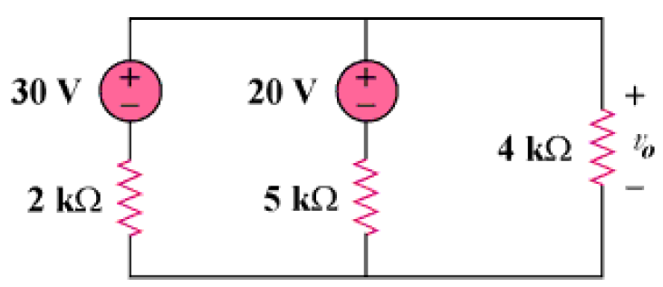
Introduction
Analyse the circuit shown in figure and calculate v₀.
Lecture 12

Slide 3
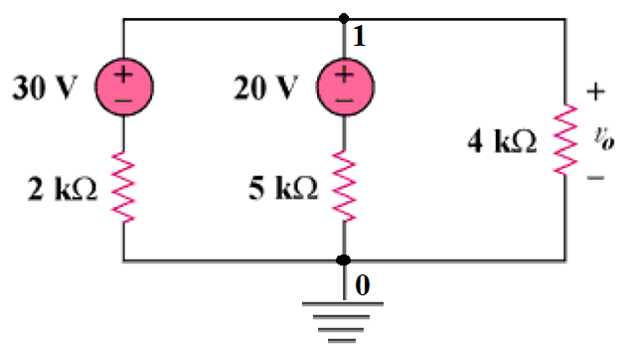
Circuit with Voltage source
The Node ‘0’ is considered as reference Node.
V₀ is the voltage at node 1.
Application of K. C. L. is required.
Lecture 12

Slide 4
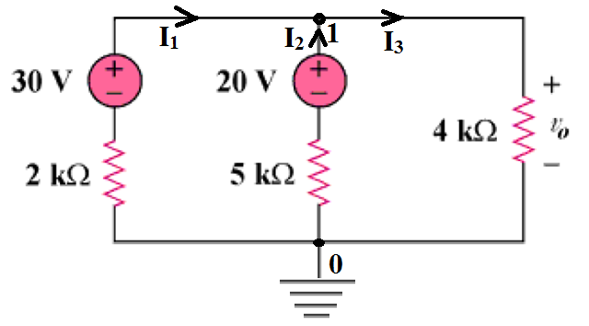
Calculation of Nodal voltage
I₁= (30-v₁)/2kΩ)
I₂= (20-v₁)/5kΩ)
I₃= (v₁/4kΩ)
I₁+I₂=I₃------------(1)
((30-v₁)/2kΩ)+((20-v₁)/5kΩ)=(v₁/4kΩ)
(30/2kΩ)-(v₁/2Ω)+(20/5kΩ)-(v₁/5kΩ)=(v₁/4kΩ)
------------(2)
Equation (2)*20KΩ
10*30-10*v₁+4*20-4*v₁=5*v₁
v₁=20V=v₀
Lecture 12

Slide 5
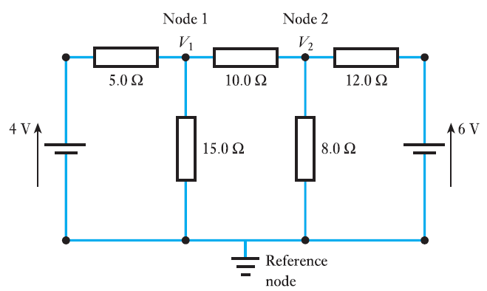
Analyze the circuit and calculate V₁ and V₂ using Nodal analysis
Lecture 12

Slide 6
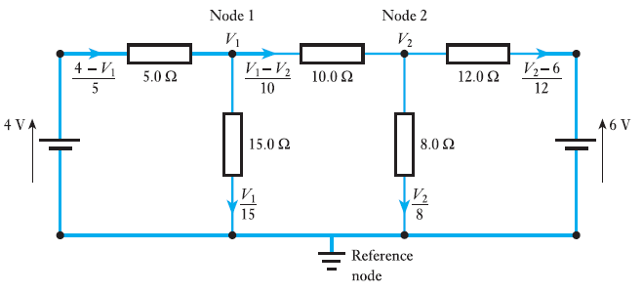
Currents in each connection to each Node
At Node 1 applying K. C. L.
(4-v₁)/5=(v₁-v₂)/10+(v₁/15) ----------- (1)
Multiply equation (1) by 30
24 − 6v₁ = 3v₁ − 3v₂ + 2v₁------------ (2)
Lecture 12

Slide 7
Current flow in a resistor
11v₁ − 3v₂ = 24 ---------------(3)
At node 2
(v₁-v₂)/10 =(v₂-6)/12+v₂/8 --(4)
Lecture 12

Slide 8
Application of K. C. L. at Node 2
At node 2
(v₁-v₂)/10 =(v₂-6)/12+v₂/8 --(4)
Multiply (4) by 120
12v₁ − 12v₂ = 10v₂ − 60 + 15v₂ ----- (5)
Lecture 12

Slide 9
12v₁ − 37v₂ = −60 ------ (6)
11v₁ − 3v₂ = 24 ---------(3) on solving
v₂ = 2.55 V
v₁ = 2.88 V
Lecture 12

Slide 10
Thank You
Lecture 12

